Slide 1
Error Handler Rework
Fault Tolerance Working Group

Slide 2
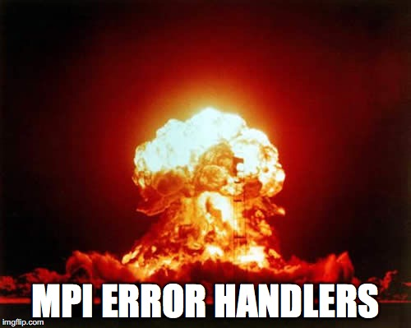
Motivation
In Portland (March 2015), Tony charged us with greenfielding Error Handlers and coming up with a wishlist of what we really want.
We’d figure out backward compatibility “later”.

Slide 3
Error Handler Rework Wish List
Clarify what you are allowed to do in an error handler
Return new error codes from an error handler
Handle with QMPI
Pick which error classes we handle in a single function
Multiple error handlers attached to a single object
Be able to recreate operations if desired
Handle with QMPI
Combine the three error handler functions into a single one to be able to assign generically

Slide 4
Clarify what you’re allowed to do in an errhandler
What are you allowed to do in an error handler?
MPI calls?
Communication?
Long jump?
Finalize?

Slide 5
Clarify what you’re allowed to do in an errhandler
What are you allowed to do in an error handler?
MPI calls?
Communication?
Long jump?
Finalize?
Probably want to allow everything, but point out that error handlers are local and the user is responsible for matching.
Some of these will be very tricky to implement correctly with threads but we think it might not be so bad given that error handling generally happens at the end.
Notes:
All of these are already used in fault tolerance libraries and they “work”. It may be an accident that they work though.

Slide 6
Return New Error Code From Error Handler
Do this with QMPI
MPI_ERR_MEM
Make error codes INOUT instead of just IN
Allows the error handler to handle/mask errors
If the incoming error class is MPI_ERR_MEM, we could free some memory, retry the call, and return MPI_SUCCESS.
Error Handler
MPI_SUCCESS

Slide 7
Return New Error Code From Error Handler Dangers
Do this with QMPI
MPI_ERR_PROC_FAILED
Converting one error class to another could be very confusing for the user if not done carefully.
e.g. Changing MPI_ERR_PROC_FAILED to MPI_ERR_ARG would make user error handling very hard.
Error Handler
MPI_ERR_ARG

Slide 8
Return New Error Code From Error Handler Dangers
Do this with QMPI
MPI_ERR_PROC_FAILED
This could cause a big pain if we trigger another error handler based on the changed error code (would require MPI to check error codes on the way out of the error handler).
We won’t trigger a second error handler after the first one returns
We could still have nested error handlers
Error Handler
Oh God
not again!
MPI_ERR_ARG

Slide 9
Return New Error Code From Error Handler Good Example
Do this with QMPI
MPI_Set_Errhandler(MPI_COMM_SELF, errhandler1);
rc = MPI_Alloc_mem(...);
errhandler1(..., int *errcode, ...) {
free(some_scratch_space);
MPI_Alloc_mem(...); /* With the same args */
*errcode = MPI_SUCCESS;
}
/* rc == MPI_SUCCESS (hooray!) */

Slide 10
Return New Error Code From Error Handler Bad Example
Do this with QMPI
MPI_Set_Errhandler(MPI_COMM_WORLD, errhandler1);
rc = MPI_Bcast(..., MPI_COMM_WORLD);
errhandler1(..., int *errcode, ...) {
rc = MPI_Comm_dup(MPI_COMM_WORLD, &comm1); /* for some reason */
/* rc == MPI_SUCCESS */
rc = MPI_Comm_shrink(comm1, &comm2);
/* rc == MPI_ERR_OTHER (out of cids) */
*errcode = rc;
}
/* rc == MPI_ERR_OTHER (huh?) */

Slide 11
Pick Error Classes to Handle
Handler
Add array of error classes to the MPI_Errhandler_set function
Only call this error handler when an error class in the array is raised
Have ”generic” error handler for all other cases
Set a default and overwrite it for specific cases
Add a predefined value for MPI_ANY_ERROR
Helpful for FT libraries (e.g. Fenix)
MPI_ERR_PROC_FAILED
Error
MPI_ERR_MEM
Handler
MPI_ANY_ERROR
Handler

Slide 12
Multiple Error Handlers
Still only allow a single error handler for a particular error class
Specific error classes overwrite the general MPI_ANY_ERROR handler
Error
Handler
Other
Handler

Slide 13
Guarantee that MPI is long jump safe
Allow the error handler to long jump to a location after the function is completed
User’s responsibility to make sure that it doesn’t screw up its own threads
It might not currently be safe to long jump directly out of the error handler because you might be in MPI’s thread.
In practice, we don’t think implementations do this, but the Standard doesn’t prohibit it. We should clarify this.
This gives you Reinit/Fenix-like behavior

Slide 14
Provider Error Handler with Operation Context
Do this with QMPI
Pass in operation arguments with something like varargs
Can re-run the operation after fixing the problem
Could be tricky to use, but would be very powerful for some recovery:
Catastrophic/non-catastrophic
Message logging
Thought about this and decided that it would be great implementation-specific behavior to shove in the “…” at the end.

Slide 15
One Errhandler to Rule Them All
Need a way to get a communicator from a request to be able to match up objects.
typedef void MPI_Errhandler_function(
(IN) void * handles, /* Request(s) if they exist,
otherwise comm/win/file/etc. */
(IN) int num_handles, /* Num handles in the previous array? */
(IN) int/enum * handle_types, /* req,comm,win,file */
(INOUT) int * errcode, /* Just one, maybe MPI_ERR_IN_STATUS */
(IN) void * context, /* User can log operations or something */
…); /* Implementation specific */
int MPI_Set_errhandler(
(IN) void * handle, /* Which handle does this apply to? */
(IN) int * error_classes, /* Which error classes to catch
Could be MPI_ANY_ERR_CLASS */
(IN) int num_error_classes, /* Num classes in the previous array */
(IN) void * context, /* User specific */
(IN) MPI_Errhandler errhandler);

